Slide 1

NORTON’s theorem
Engr. Muhammad Waqas

Slide 2
NORTON’s Theorem Procedure
Identify and remove the load
Look in the load terminals and calculate I_{N}
Remove all sources by replacing:
  voltage sources with a short
  current sources with an open
  If the source has an internal resistance, keep the resistance in the circuit
Look in the load terminals and calculate R_{N}
Create a parallel circuit consisting of I_{N}, R_{N}, and the load
Calculate the load current or voltage as desired

Slide 3
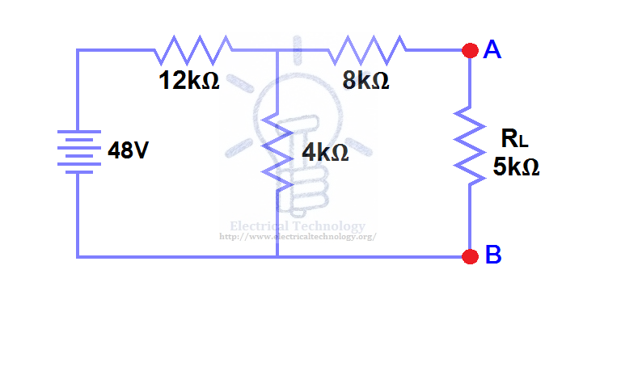
Thevenin Example 1
Identify Load Use RL

Slide 4
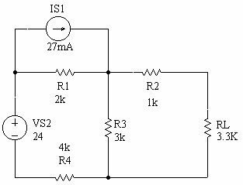
Thevenin Example 2
Identify Load Use RL

Slide 5
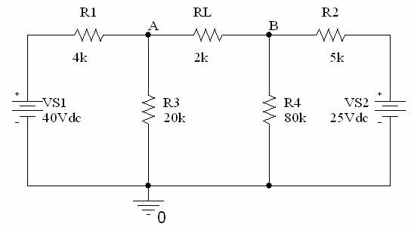
Thevenin Example 3
Identify Load Use RL

Slide 6
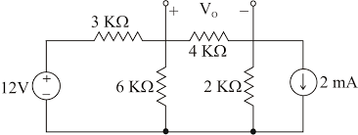
Thevenin Example 3 Solution

Slide 7
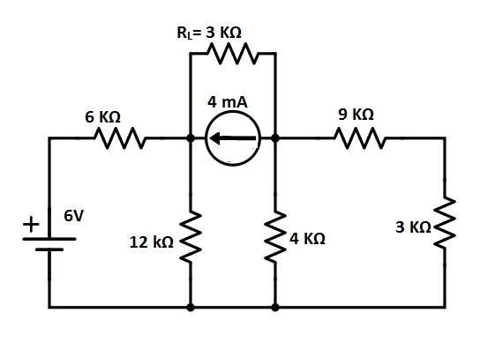
Thevenin Example 3 Solution

Slide 8
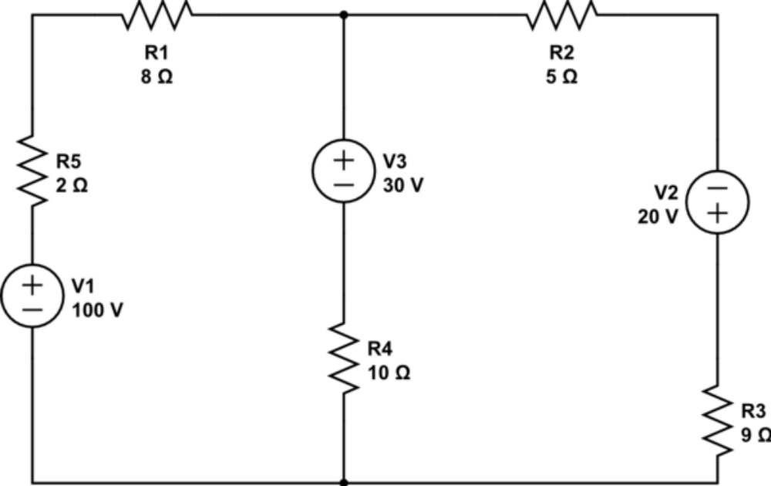
Find the Voltage drop across R4 in the following circuit.

Slide 9
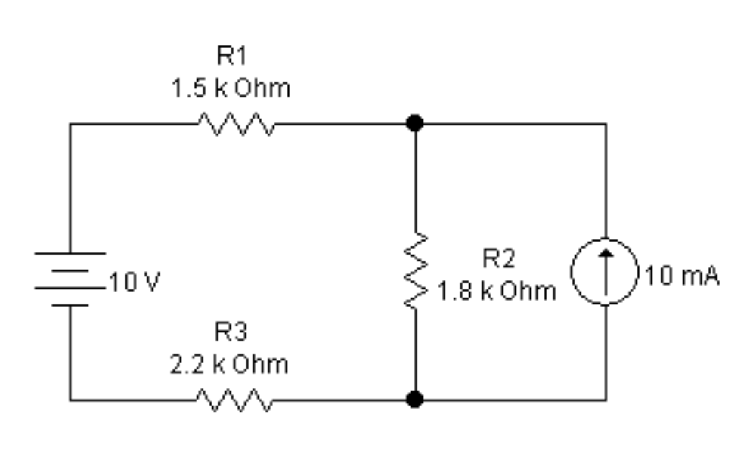
Voltage drop across R2

Slide 10
Book Source: A

